Slide 1


Loyalty ∙ Practicability ∙ Quality ∙ Diligence
CUTTING MATERIAL MANAGEMENT SYSTEM

Slide 2
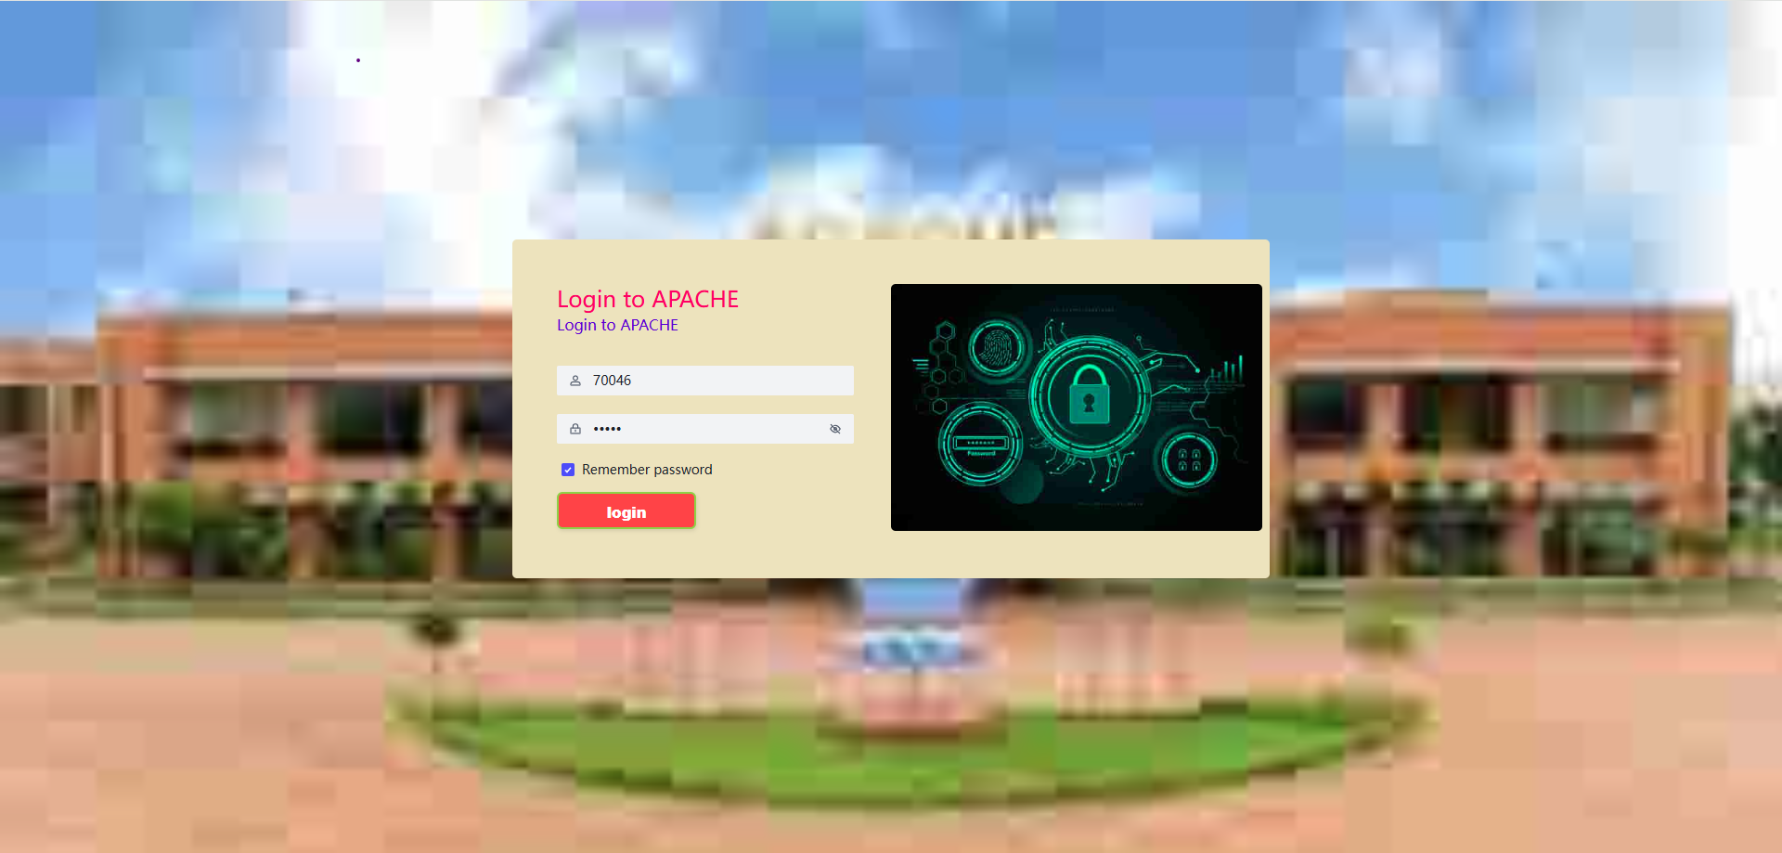
This is our APC Cutting Material Management System Portal. You can login username and password provided by MES.

Slide 3
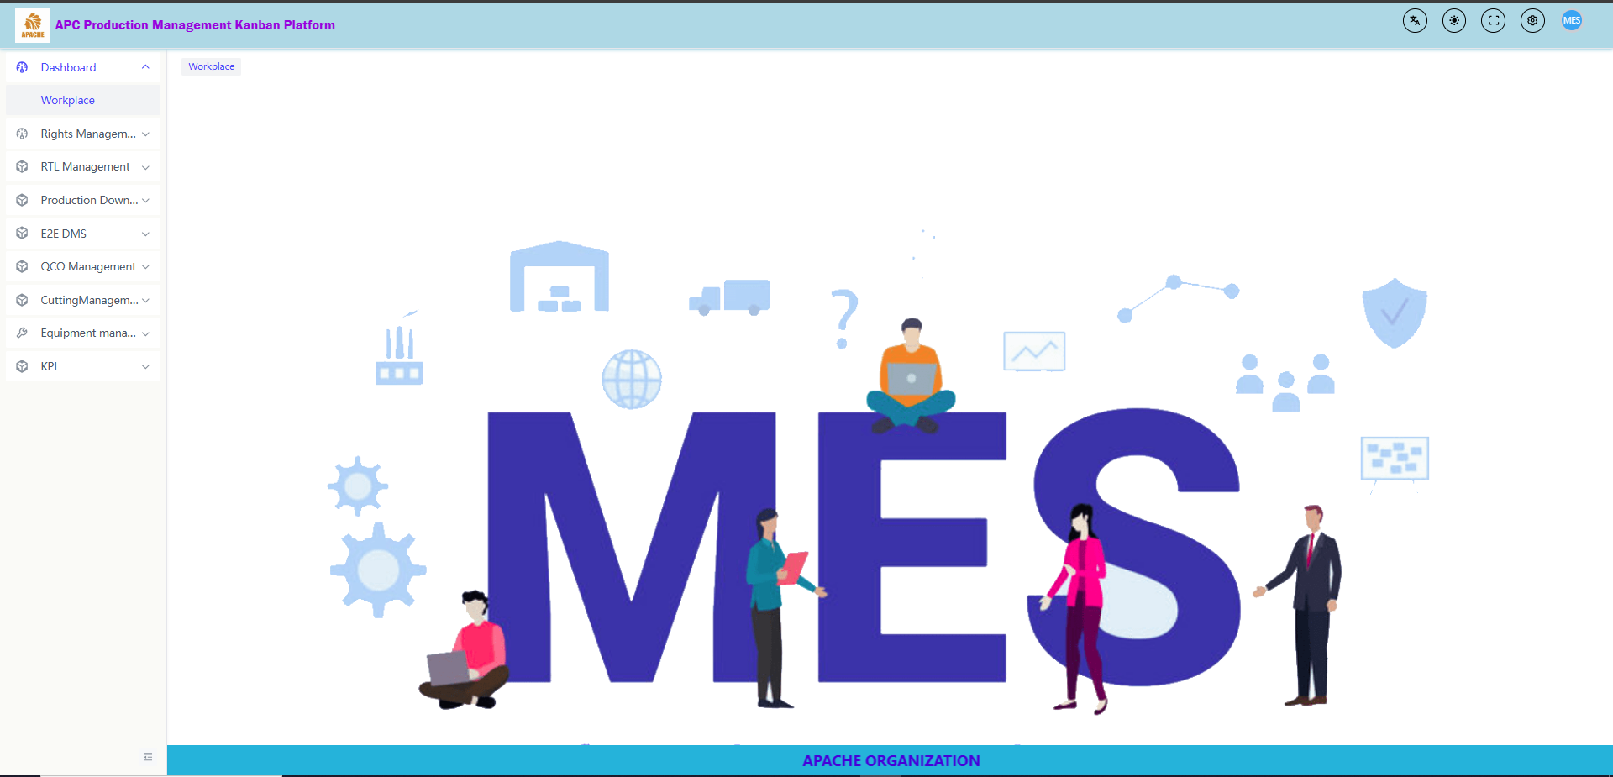
This is our frontend Main Page

Slide 4
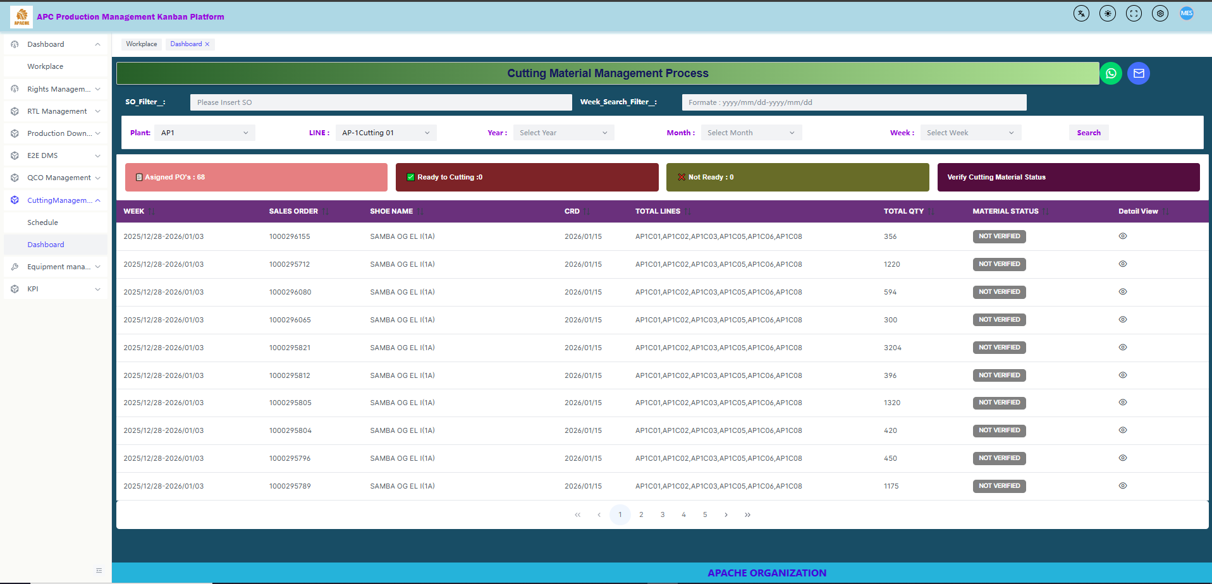
Here we can check the schedule data , based on production schedule and check material status for click button

Slide 5
Here we check that how many pos are ready to cutting and how many are not ready and total pos
Here we will send escalation to departments

Slide 6
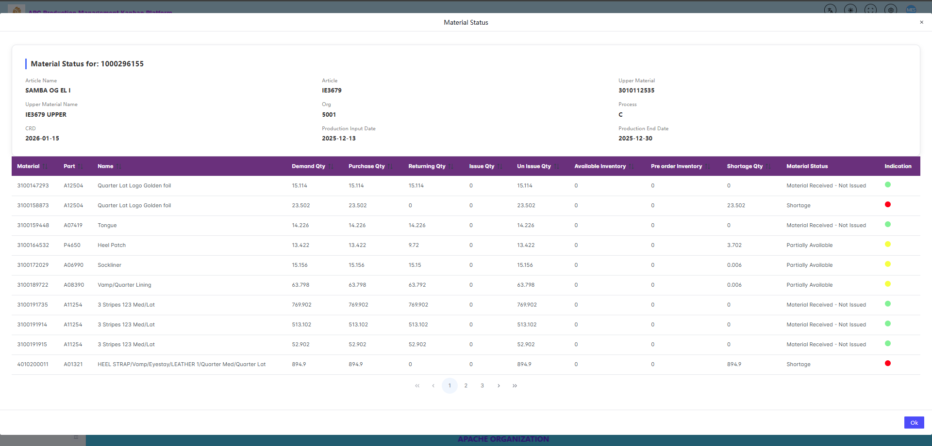
Here we check material status for each material

Slide 7
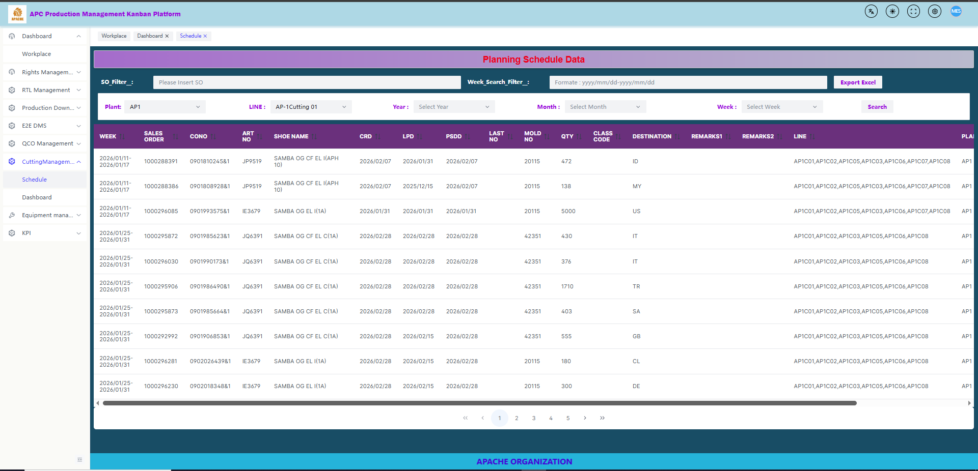
This function is used to check bulk schedule data

Slide 8
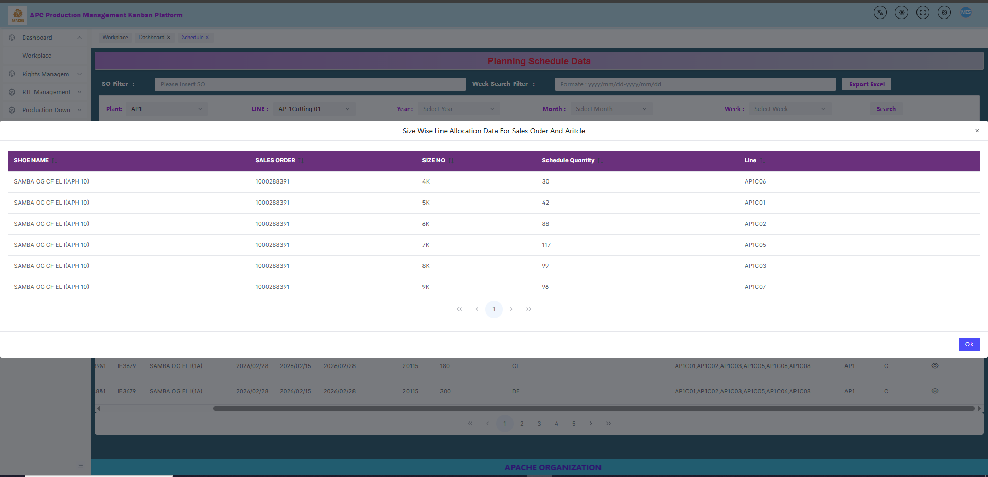
This function is used to check size wise schedule data for SO

Slide 9


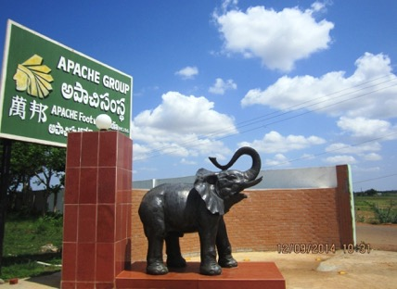
Loyalty ∙ Practicability ∙ Quality ∙ Diligence
THE END & THANKS

